Slide 1
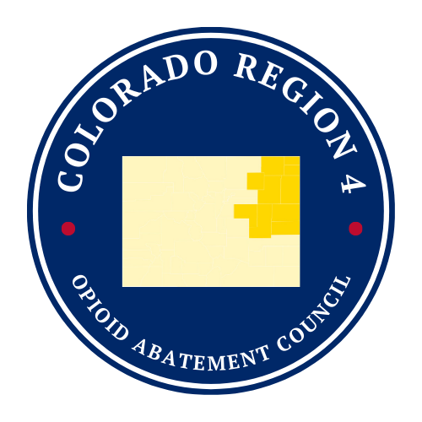









Colorado Region 4
Opioid Abatement Council
Funding Recap | 2024-2025
TRANSPORTATION
6,225 Rides
In 2023, the Region 4 Council awarded Centennial Mental Health Center (CMHC) and North Colorado Health Alliance (NCHA) funding to expand transportation to Substance Use Disorder services. Individuals from 9 of the 10 counties in Region 4 received transportation services.
The data to the right displays totals from CMHC and NCHA from Oct. 1, 2024 – Sep. 30, 2025.
705 People
Transported
186,400
Total Miles Driven
12 Hospitals and 33 Partners involved in new initiatives
TREATMENT & RECOVERY
100 Incoming and 61 Outgoing Referrals to SUD Services
In its second round of funding, the Region 4 Council awarded the Colorado Rural Opioid & Addiction Treatment System (ROOTS) with funds to improve access to treatment and recovery services in the region through care coordination, educational programming, and technical assistance. ROOTS programming served 10 of 10 Region 4 counties.
The data to the left displays totals from ROOTS from Oct. 1, 2024 – Sep. 30, 2025.
8 Virtual Trainings and 12 Continuing Medical Education Trainings Held
JAIL-BASED MOUD
In 2024, six jails within Colorado’s Region 4 lost funding to support their medications for opioid use disorder (MOUD) programs. MOUD is an evidence-based treatment approach that uses medicine to help people with opioid use disorder (OUD) manage withdrawal symptoms and cravings.
The Region 4 Council approved abatement funding to maintain these programs. Funding supported MOUD in 3 county jails.
The data to the right displays totals from Jul. 1, 2024 – Sep. 30, 2025.
83 People Treated with MOUD
142 Instances of MOUD administered in Region 4 jails
To learn more about these programs, visit yumacounty.net/grant-evaluations/

